Slide 1
String as a Character array

Slide 2
Initialization of null-terminated character sequences
Arrays of characters or strings are ordinary arrays they follow the same rules of arrays.
For example:
char myword[ ] = { 'H', 'e', 'l', 'l', 'o', '\0' };
Arrays of char elements have an additional method to initialize their values: using string literals.
Eg: char myword[] = “Hello”;

Slide 3
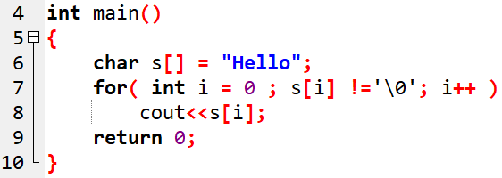
Example-1

Slide 4
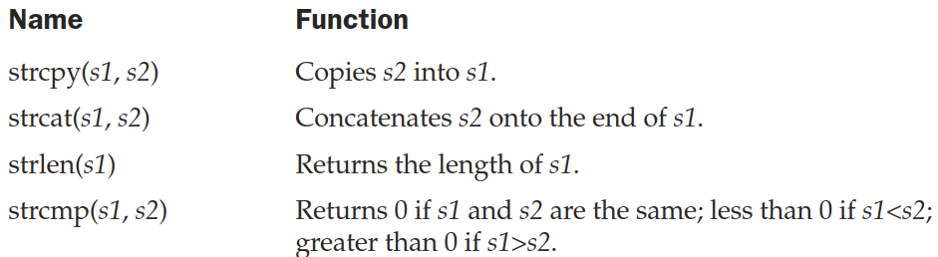
String functions

Slide 5
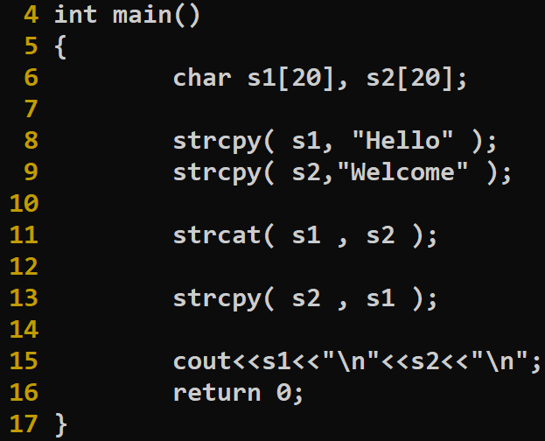

OUTPUT

Slide 6
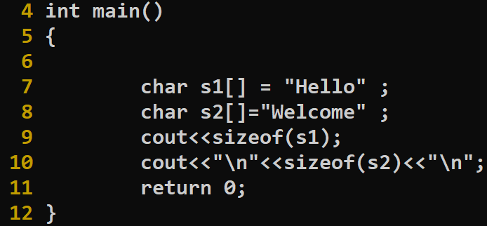
OUTPUT

Slide 7
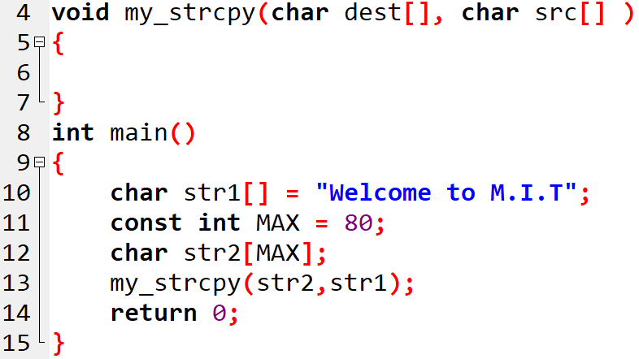
Implementing strcpy()

Slide 8
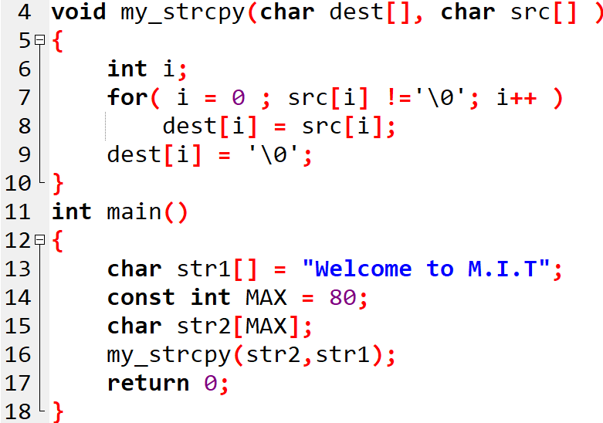
Implementing strcpy()

Slide 9
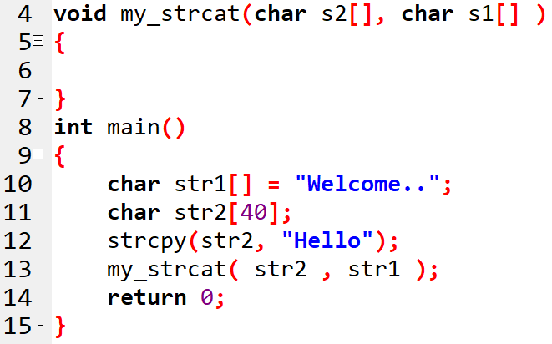
Implementing strcat()

Slide 10
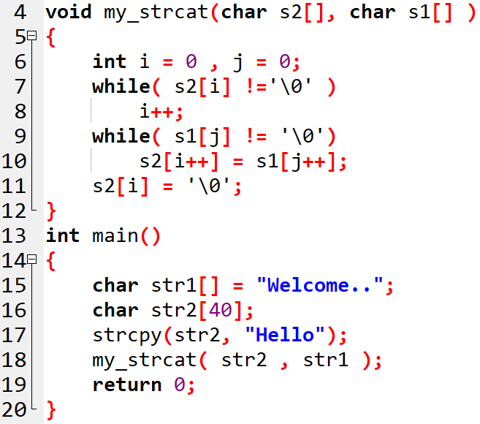
Implementing strcat()

Slide 11
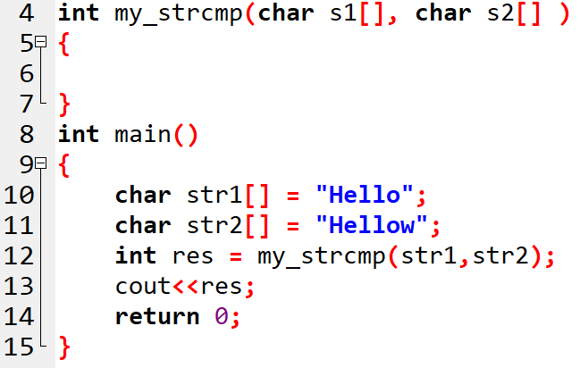
Implementing strcmp()

Slide 12
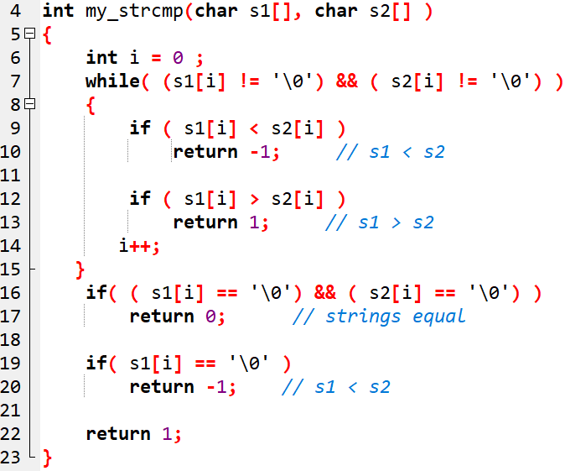
Implementing strcmp()

Slide 13
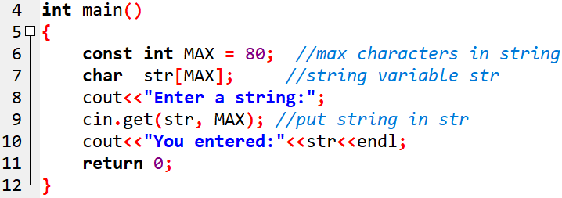
Reading Embedded Blanks
To read text containing blanks we use function,
cin :: get( )
i.e cin.get(array_name, size)
Example-2

Slide 14
Reading Multiple Lines
we use third argument in cin::get() function.
cin.get(array_name, size, stop_char)
The argument stop_char specifies the character that tells the function to stop reading. The default value for this argument is the newline (‘\n’) character, but if you call the function with some other character for this argument, the default will be overridden by the specified character.

Slide 15
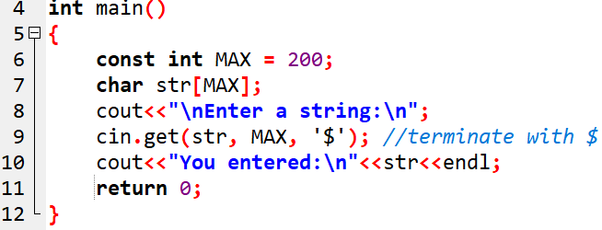
Reading Multiple Lines Example-4
Now you can type as many lines of input as you want. The function will continue to accept characters until you enter the terminating character (or until you exceed the size of the array). Remember, you must still press [Enter] after typing the ‘$’ character.

Slide 16
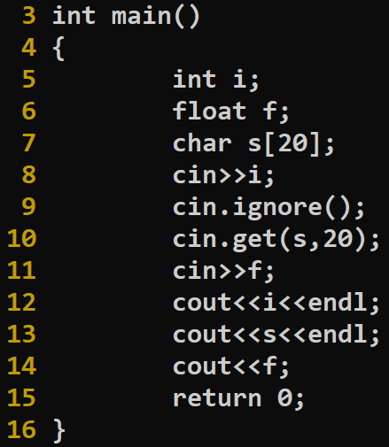

Slide 17
cin.getline() vs cin.get()
cin.getline() reads input up to ‘\n’ and stops
cin.get() reads input up to ‘\n’ and keeps ‘\n’ in the stream

Slide 18
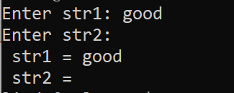
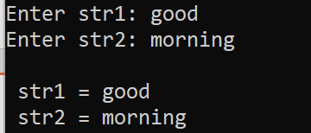
#include<iostream>
#include<cstring>
using namespace std;
int main ()
{
char str1[25], str2[25];
cout<<"Enter str1: ";
cin.getline(str1 , 25 );
cout<<"Enter str2: ";
cin.get(str2 , 25 );
cout<<"\n str1 = "<<str1<<"\n str2 = "<<str2<<endl;
/*
cout<<"Enter str1: ";
cin.get(str1 , 25);
cout<<"Enter str2: ";
cin.getline(str2 , 25);
cout<<"\n str1 = "<<str1<<"\n str2 = "<<str2<<endl;
*/
}

